Slide 1
Wide Area Network Connectivity

Slide 2
WAN Connectivity
WAN connectivity options include the following:
Broadband – cables and bandwidth are shared between multiple customers
The ISP makes a “best effort” attempt to provide up to advertised bandwidth
Bandwidth is asymmetrical (asynchronous) which means download speeds are faster than upload speeds
DIA (dedicated internet access) – bandwidth is dedicated to a single customer
Bandwidth is symmetrical (synchronous) which means download and upload speeds are about the same
This is important for businesses that back up large amounts of data online

Slide 3
DSL (Digital Subscriber Line) (1 of 2)
DSL (digital subscriber line) is a WAN connection method that operates over the PSTN (public switched telephone network)
DSL supports multiple data and voice channels over a single line
It requires repeaters for longer distances
The distance between the customer and CO affect actual throughput
DSL uses advanced data modulation techniques
A DSL connection might use a modulation technique based on amplitude or phase modulation to alter the waves at higher frequencies to carry data

Slide 4
DSL (Digital Subscriber Line) (2 of 2)
The types of DSL vary according to their throughput rates, data modulation techniques, capacity, and distance limitations
xDSL refers to all DSL varieties and the x is replaced by the variety’s name

Slide 5
DSL (Digital Subscriber Line) (2 of 2)
Better-known DSL varieties:
ADSL (asymmetric DSL) – faster download speeds than upload speeds
Most common form of DSL
Best use of ADSL is video conferencing and web surfing
VDSL (very high bit rate DSL or variable DSL) – faster than ADSL and is also asymmetric
SDSL (symmetric DSL) – has equal download and upload speeds maxing out around 2 Mbps
Best use of SDSL is uploading and downloading significant data amounts

Slide 6
Cable Broadband (1 of 3)
Cable broadband (also called cable Internet or cable modem access) is based on coaxial cable wiring used for TV signals
Cable broadband was standardised by an international cooperative effort
It yielded a suite of specifications called DOCSIS (Data Over Cable Service Interface Specifications)

Slide 7
Cable Broadband (1 of 3)
Service is typically offered at asymmetric speeds
Such as up to 70 Mbps download and 7 Mbps upload
The newest DOCIS standard is 4.0 and allows for symmetric multi-gigabit speeds up to 10 Gbps downstream and 6 Gbps upstream
HFC (hybrid fibre coaxial) networks use fibre-optic cabling to connect the cable company’s distribution center to distribution hubs and then to optical nodes near customers

Slide 8
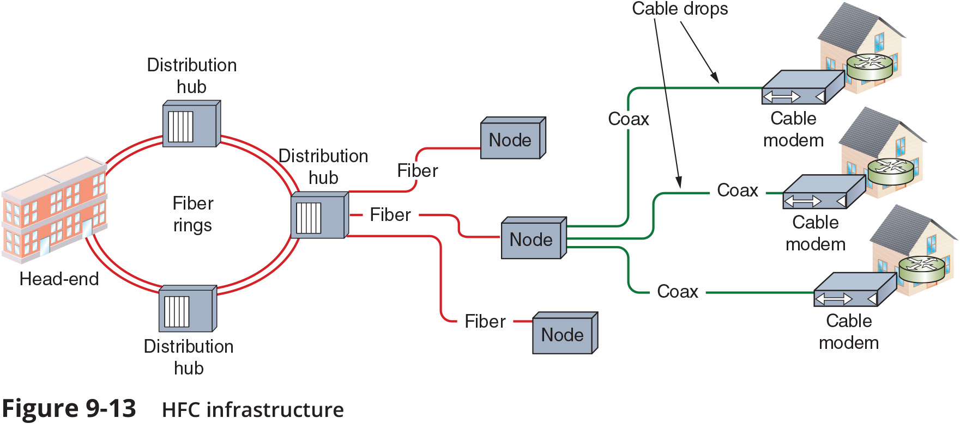
Cable Broadband (2 of 3)

Slide 9
Cable Broadband (3 of 3)
A cable modem modulates and demodulates signals for transmission and reception via cable wiring
They operate at the physical and data Link layers of the OSI model
A cable modem may connect to connectivity device such as a router or switch
It is possible to use a device that combines cable modem functionality with a SOHO router to share available bandwidth on an entire network
Cable broadband provides a dedicated and continuous connection
It does require many subscribers to share the same local line which raises concerns about security and actual throughput

Slide 10
Fibre (1 of 2)
A growing trend in ISP offerings for WAN connection services is to offer the following:
FTTN (fibre-to-the-node or fibre-to-the-neighbourhood)
FTTC (fibre-to-the-curb)
FTTB (fibre-to-the-building) or FTTH (fibre-to-the-home)
MONs (metropolitan optical networks) bring fibre to the customer

Slide 11
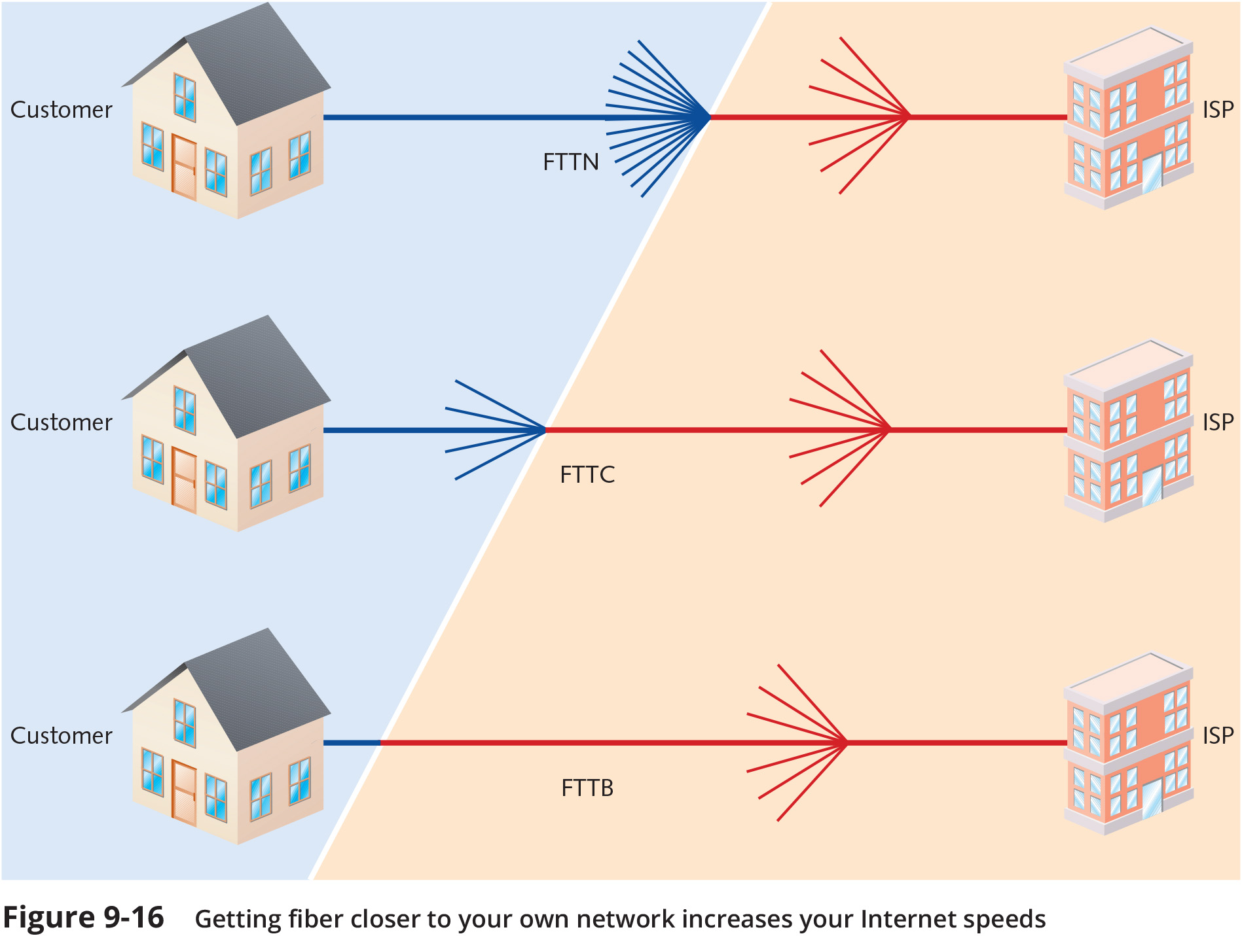
Fibre (2 of 2)

Slide 12
Leased Lines
Leased lines provide dedicated bandwidth on fibre optic connections
A dedicated line offers the following advantages:
Dedicated bandwidth
Symmetrical bandwidth
SLA-backed guarantee
Ongoing monthly costs of a leased line vary greatly depending on many factors:
Required bandwidth
The distance to the ISP’s exchange or between the company’s own locations

Slide 13
MPLS (Multiprotocol Label Switching) (1 of 2)
MPLS (multiprotocol label switching) enables multiple types of Layer 3 protocols to travel over any one of several connection-oriented Layer 2 protocols
MPLS can handle various types of payloads
It is often used by ISPs on their own networks for moving traffic from one customer site to another

Slide 14
MPLS (Multiprotocol Label Switching) (1 of 2)
MPLS labels include information about where the router should forward the message next
The labels may also include prioritisation information
The primary benefits of MPLS include the following:
MPLS connections are highly scalable for business
Customers can prioritise their own traffic across the WAN
The ability to label traffic offers more reliability, predictability, and security

Slide 15
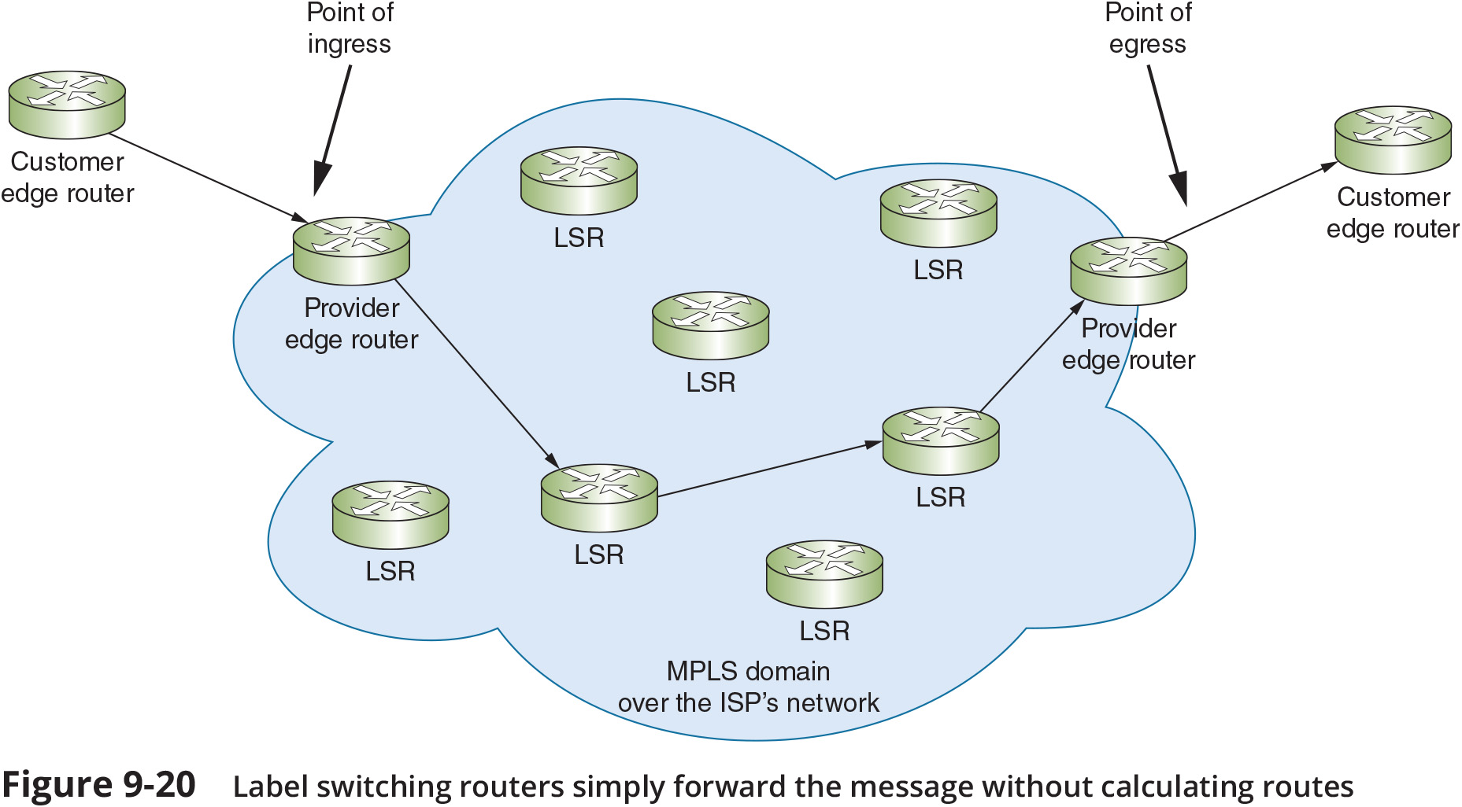
MPLS (Multiprotocol Label Switching) (2 of 2)

Slide 16
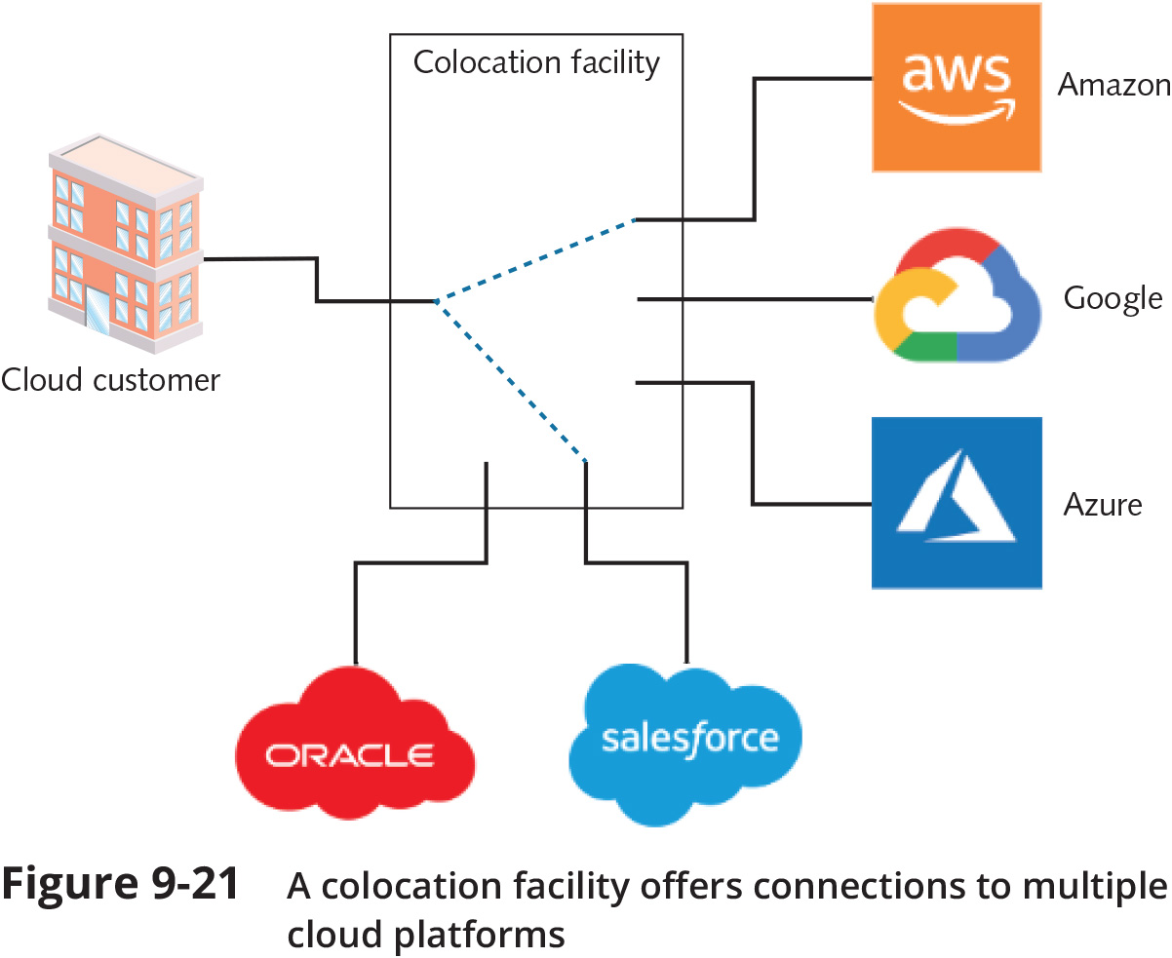
Cloud Connectivity Options

Slide 17
Software-defined WAN (SD-WAN) (1 of 2)
SD-WAN (software-defined wide area network) relies on abstracted, centralised control of networking devices to manage network functions across a diverse infrastructure
SD-WAN offers the following benefits:
Transport agnostic
Active-active load balancing and automatic failover
Intent-based management
Zero-touch provisioning
Reduced cost

Slide 18
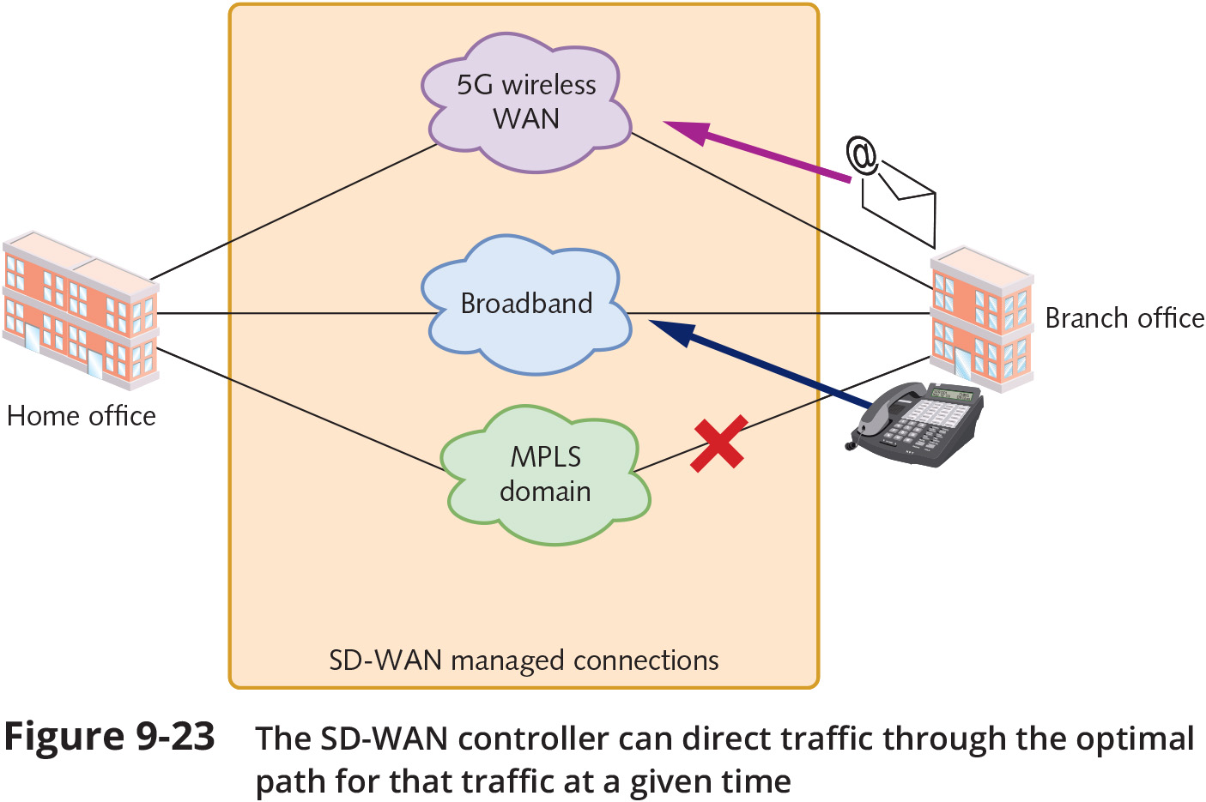
Software-defined WAN (SD-WAN) (2 of 2)

